Slide 1
Unit-I(2nd Part): Virtual Machines and Virtualization of Clusters and datacenters From book: Distributed and Cloud Computing K. Hwang, G. Fox and J. Dongarra

Slide 2
Virtualization for Datacenter Automation to serve millions of clients, simultaneously
Server Consolidation in Virtualized Datacenter
Virtual Storage Provisioning and De provisioning
Cloud Operating Systems for Virtual Datacenters
Trust Management in virtualized Datacenters

Slide 3
Implementation Levels of Virtualization
Virtualization is a computer architecture technology by which multiple virtual machines (VMs) are multiplexed in the same hardware machine.
The idea of VMs can be dated back to the 1960s.
The purpose of a VM is to enhance resource sharing by many users and improve computer performance in terms of resource utilization and application flexibility.
Hardware resources (CPU, memory, I/O devices, etc.) or software resources (operating system and software libraries) can be virtualized in various functional layers.
This virtualization technology has been revitalized as the demand for distributed and cloud computing increased sharply in recent years.

Slide 4
Levels of Virtualization Implementation
A traditional computer runs with a host operating system specially tailored for its hardware architecture.
After virtualization, different user applications managed by their own operating systems (guest OS) can run on the same hardware, independent of the host OS.
This is often done by adding additional software, called a virtualization layer.
This virtualization layer is known as hypervisor or virtual machine monitor (VMM).
The VMs are shown in the upper boxes, where applications run with their own guest OS over the virtualized CPU, memory, and I/O resources.
The main function of the software layer for virtualization is to virtualize the physical hardware of a host machine into virtual resources to be used by the VMs, exclusively.
This can be implemented at various operational levels, as we will discuss shortly. The virtualization software creates the abstraction of VMs by interposing a virtualization layer at various levels of a computer system.
Common virtualization layers include the instruction set architecture (ISA) level, hardware level, operating system level, library support level, and application level).

Slide 5
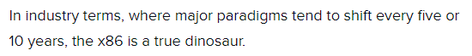
Instruction set
An instruction set, or instruction set architecture (ISA), is the part of the computer architecture related to programming, including the native data types,instructions, registers, addressing modes, memory architecture, interrupt and exception handling, and external I/O.
X86 processor : x86 is a family of backward compatible instruction set architectures ^{[a]} based on the Intel 8086 CPU and its Intel 8088 variant.
Want’s to know more about the X86 processor-
https://www.cis.upenn.edu/~cdmurphy/cit593/fall2012/pdf/lecture20-x86.pdf

Slide 6
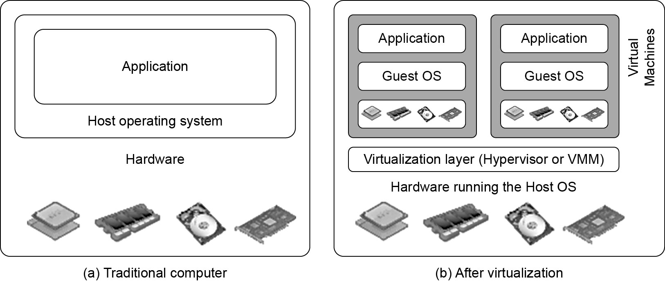
Difference between Traditional Computer and Virtual machines

Slide 7
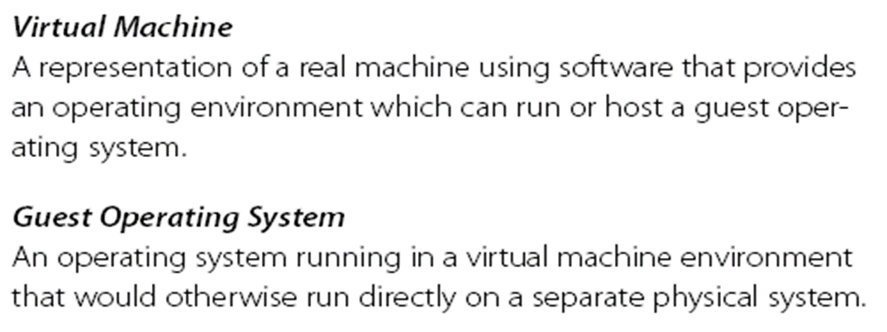
Virtual Machine, Guest Operating System, and VMM (Virtual Machine Monitor) :
The Virtualization layer is the middleware between the underlying hardware and virtual machines represented in the system, also known as virtual machine monitor (VMM)

Slide 8
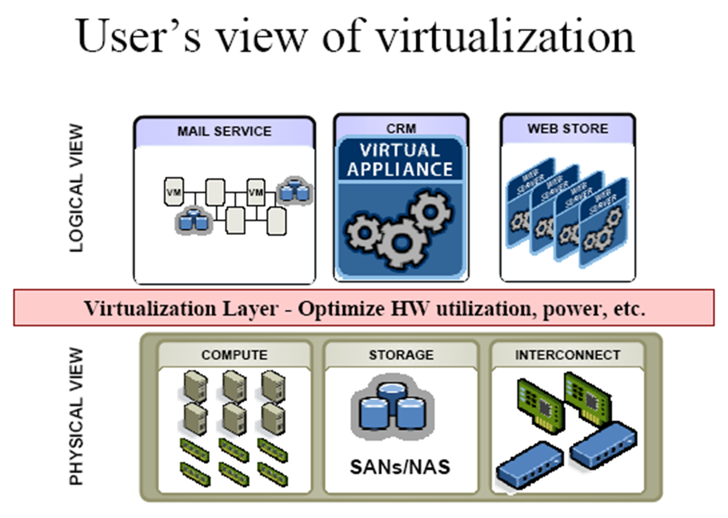

Slide 9
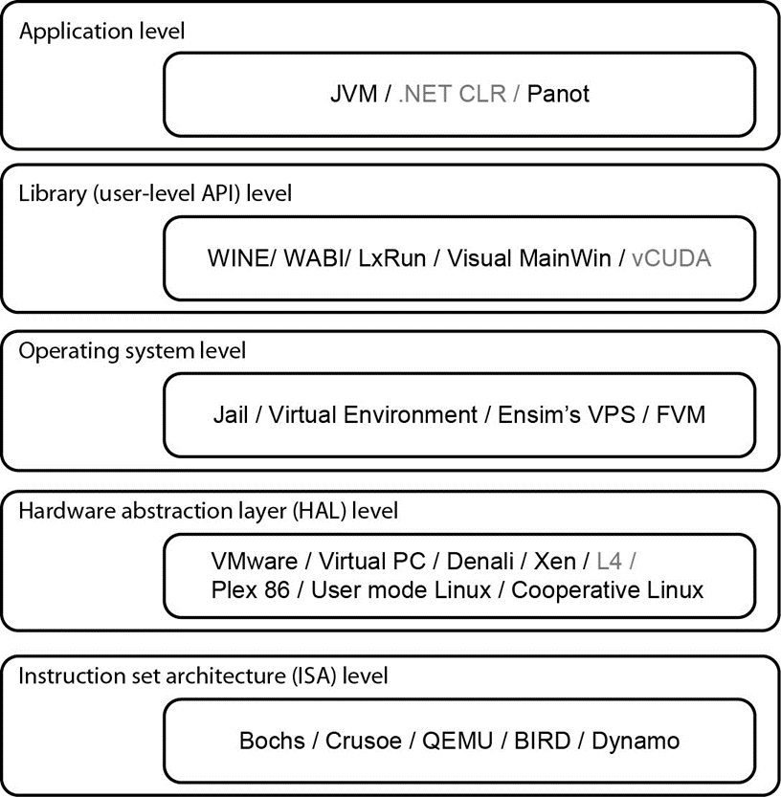
Virtualization Ranging from Hardware to Applications in Five Abstraction Levels

Slide 10
Level of virtualization implementation
Application level : Process level virtualization (HLL) high level language .
Library level : Virtual hosting environment for larger API hooks
OS level:- allocate large numbers of users
HAL (H/w abstraction layer level): to virtualize the computer resources like its processor/memory and I/o devices.
ISA (Inst. set arch.): legacy binary code can be used.

Slide 11
Virtualization at ISA (Instruction Set Architecture) level:
At the ISA level, virtualization is performed by emulating a given ISA by the ISA of the host machine.
e.g, MIPS binary code can run on an x-86-based host machine with the help of ISA emulation.
With this approach, it is possible to run a large amount of legacy binary code written for various processors on any given new hardware host machine.
Instruction set emulation leads to virtual ISAs created on any hardware machine.
The basic emulation method is through code interpretation.
An interpreter program interprets the source instructions to target instructions one by one.
One source instruction may require tens or hundreds of native target instructions to perform its function.
Obviously, this process is relatively slow.
For better performance, dynamic binary translation is desired.
This approach translates basic blocks of dynamic source instructions to target instructions.
The basic blocks can also be extended to program traces or super blocks to increase translation efficiency.
Instruction set emulation requires binary translation and optimization.
A virtual instruction set architecture (V-ISA) thus requires adding a processor-specific software translation layer to the compiler.

Slide 12
Advantage:
It can run a large amount of legacy binary codes written for various processors on any given new hardware host machines
best application flexibility
Shortcoming & limitation:
One source instruction may require tens or hundreds of native target instructions to perform its function, which is relatively slow.
V-ISA requires adding a processor-specific software translation layer in the complier.

Slide 13
Virtualization at Hardware Abstraction level:
Virtualization is performed right on top of the hardware.
It generates virtual hardware environments for VMs, and manages the underlying hardware through virtualization.
Typical systems: VMware, Virtual PC, Denali, Xen
The idea is to virtualize a computer’s resources, such as its processors, memory, and I/O devices.
The intention is to upgrade the hardware utilization rate by multiple users concurrently.
Advantage:
Has higher performance and good application isolation
Shortcoming & limitation:
Very expensive to implement (complexity)

Slide 14
Virtualization at Operating System (OS) level:
This refers to an abstraction layer between traditional OS and user applications.
This virtualization creates isolated containers on a single physical server and the OS-instance to utilize the hardware and software in datacenters.
The containers behave like real servers.
OS-level virtualization is commonly used in creating virtual hosting environments to allocate hardware resources among a large number of mutually distrusting users.
It is also used, to a lesser extent, in consolidating server hardware by moving services on separate hosts into containers or VMs on one server.
Typical systems: Jail / Virtual Environment / Ensim's VPS / FVM

Slide 15
Advantage:
Has minimal starup/shutdown cost, low resource requirement, and high scalability; synchronize VM and host state changes.
Shortcoming & limitation:
All VMs at the operating system level must have the same kind of guest OS
Poor application flexibility and isolation.

Slide 16
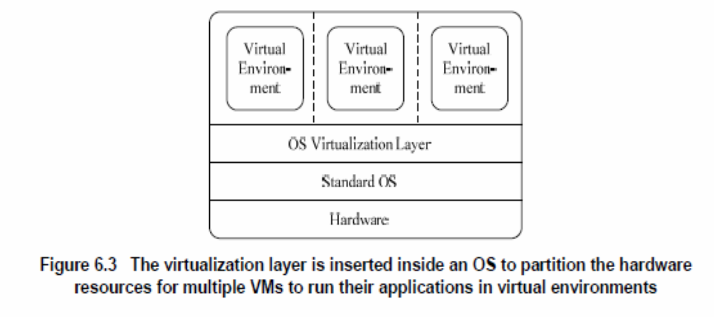
Virtualization at OS Level

Slide 17
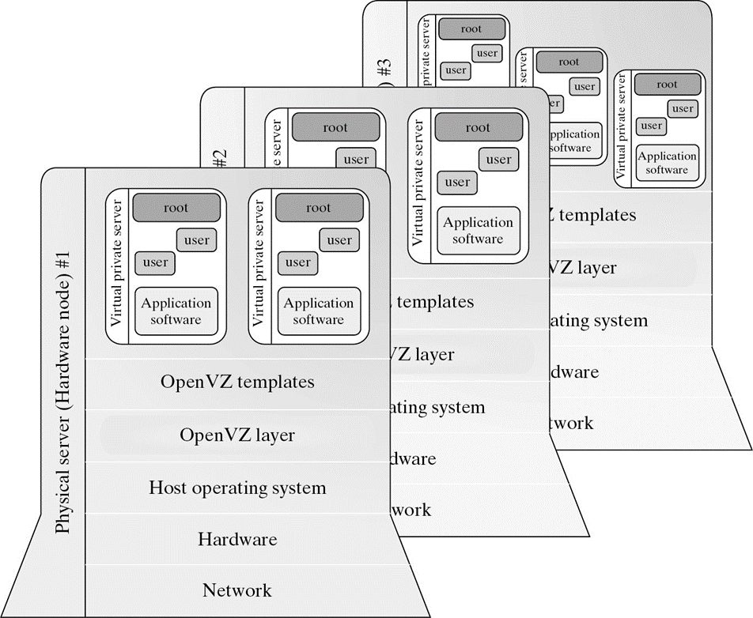
Virtualization for Linux and Windows NT Platforms

Slide 18
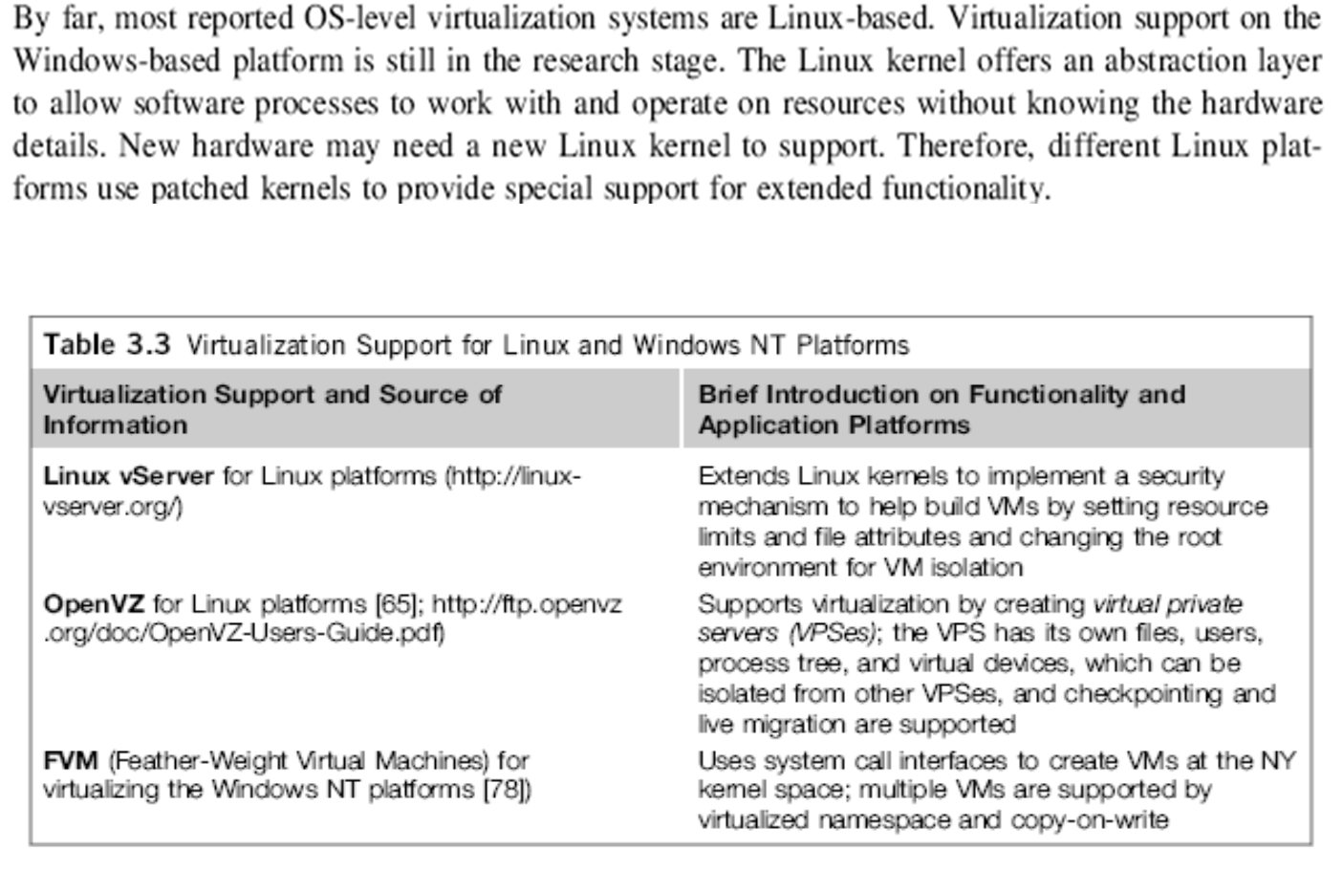

Slide 19
Advantages of OS Extension for Virtualization
VMs at OS level has minimum startup/shutdown costs
OS-level VM can easily synchronize with its environment
Disadvantage of OS Extension for Virtualization
All VMs in the same OS container must have the same or similar guest OS, which restrict application flexibility of different VMs on the same physical machine.

Slide 20
Library Support level:
Most applications use APIs exported by user-level libraries rather than using lengthy system calls by the OS.
Since most systems provide well-documented APIs, such an interface becomes another candidate for virtualization.
Virtualization with library interfaces is possible by controlling the communication link between applications and the rest of a system through API hooks.
The software tool WINE has implemented this approach to support Windows applications on top of UNIX hosts.
Another example is the vCUDA which allows applications executing within VMs to leverage GPU hardware acceleration.

Slide 21
It creates execution environments for running alien programs on a platform rather than creating VM to run the entire operating system.
It is done by API call interception and remapping.
Typical systems: Wine, WAB, LxRun , VisualMainWin
Advantage:
It has very low implementation effort
Shortcoming & limitation:
poor application flexibility and isolation

Slide 22
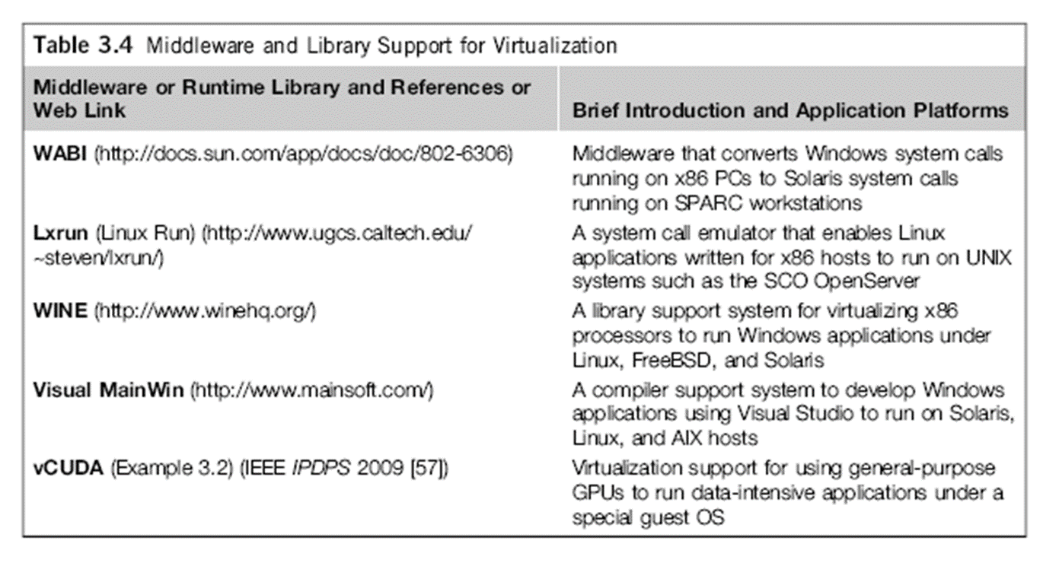
Virtualization with Middleware/Library Support

Slide 23
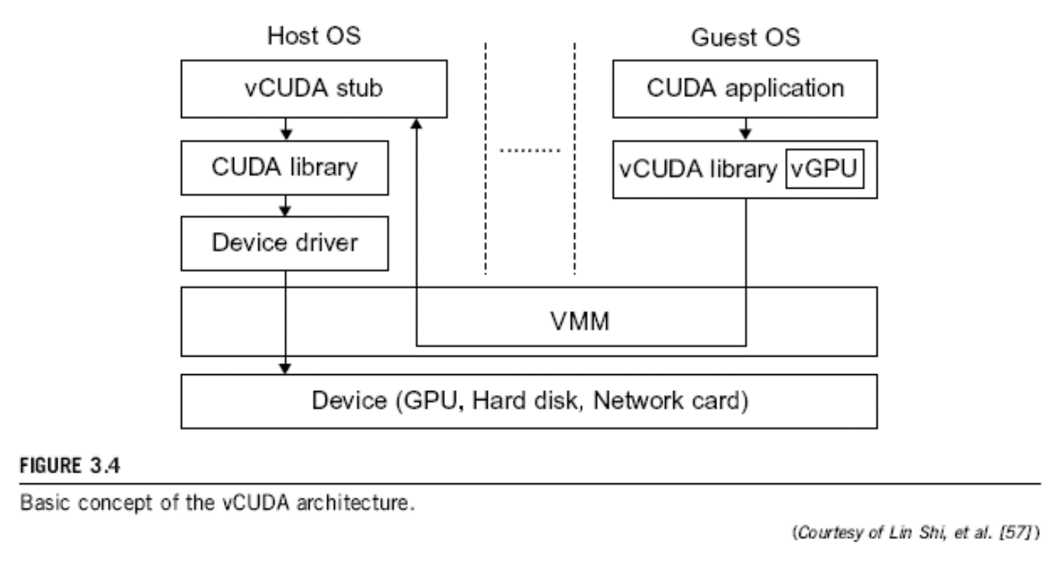
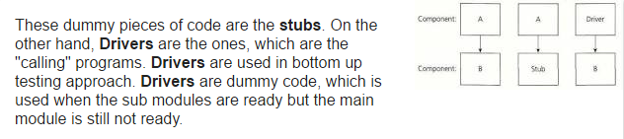
The vCUBE for Virtualization of GPGPU

Slide 24
User-Application level:
Virtualization at the application level virtualizes an application as a VM.
On a traditional OS, an application often runs as a process.
Therefore, application-level virtualization is also known as process-level virtualization.
The most popular approach is to deploy high level language (HLL) VMs.
Any program written in the HLL and compiled for this VM will be able to run on it.

Slide 25
The Microsoft .NET CLR(Common Language Runtime) and Java Virtual Machine (JVM: converting bytecode to the machine specific code) are two good examples of this class of VM.
https://en.wikipedia.org/wiki/List_of_Java_virtual_machines

Slide 26
Advantage:
Has the best application isolation
Shortcoming & limitation:
Low performance, low application flexibility and high implementation complexity.

Slide 27
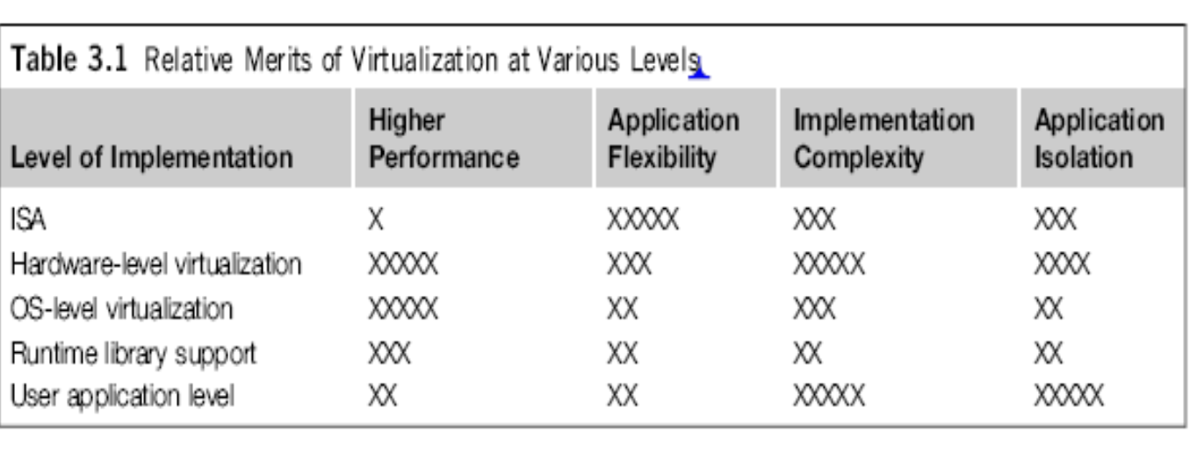
Relative merits of virtualization at various levels (More X’s means higher merit ,with a maximum of 5 X’s)
More Xs mean higher merit

Slide 28
Relative Merits of Different Approaches
The column headings correspond to four technical merits. “Higher Performance” and “Application Flexibility” are self-explanatory.
“Implementation Complexity” implies the cost to implement that particular virtualization level.
“Application Isolation” refers to the effort required to isolate resources committed to different VMs. Each row corresponds to a particular level of virtualization.
However, the hardware and application levels are also the most expensive to implement.
User isolation is the most difficult to achieve.
ISA implementation offers the best application flexibility.

Slide 29
Hypervisor
A hypervisor is a hardware virtualization technique allowing multiple operating systems, called guests to run on a host machine. This is also called the Virtual Machine Monitor (VMM).

Slide 30
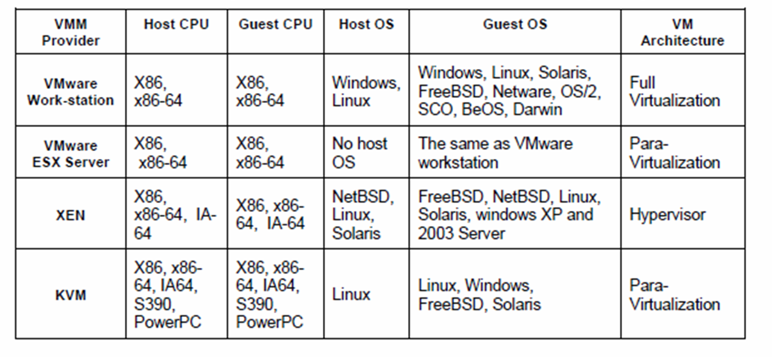
Major VMM and Hypervisor Providers (self study)

Slide 31
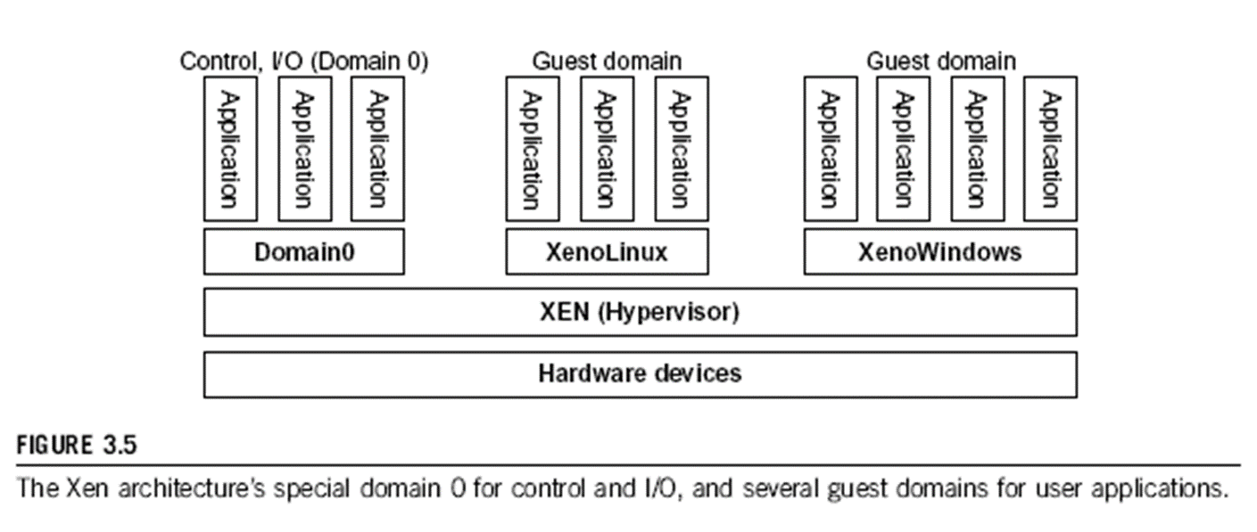
The XEN Architecture

Slide 32
The XEN Architecture
Xen is an open source hypervisor program developed by Cambridge University.
Xen is a microkernel hypervisor, which separates the policy from the mechanism.
The Xen hypervisor implements all the mechanisms, leaving the policy to be handled by Domain 0.
Xen does not include any device drivers natively.
It just provides a mechanism by which a guest OS can have direct access to the physical devices.
As a result, the size of the Xen hypervisor is kept rather small.
Xen provides a virtual environment located between the hardware and the OS.
A number of vendors are in the process of developing commercial Xen hypervisors, among them are Citrix XenServer and Oracle VM.

Slide 33
For example, Xen is based on Linux and its security level is C2. (U.S. National Computer SecurityCenter (NCSC) and granted to products that pass Department of Defense (DoD) Trusted Computer System Evaluation Criteria (TCSEC) tests)
Its management VM is named Domain 0, which has the privilege to manage other VMs implemented on the same host.
If Domain 0 is compromised, the hacker can control the entire system.
So, in the VM system, security policies are needed to improve the security of Domain 0.
Domain 0, behaving as a VMM, allows users to create, copy, save, read, modify, share, migrate, and roll back VMs as easily as manipulating a file, which flexibly provides tremendous benefits for users.
Unfortunately, it also brings a series of security problems during the software life cycle and data lifetime.

Slide 34
Full Virtualization vs. Para-Virtualization Full virtualization: https://www.youtube.com/watch?v=CLR0pq9dy4g&t=2s Para virtualization: https://www.youtube.com/watch?v=_Tltue_pa-o
Full virtualization
Does not need to modify guest OS, and critical instructions are emulated by software through the use of binary translation.
VMware Workstation applies full virtualization, which uses binary translation to automatically modify x86 software on-the-fly to replace critical instructions.
Advantage: no need to modify OS.
Disadvantage: binary translation slows down the performance.

Slide 35
Para virtualization
Reduces the overhead, but cost of maintaining a paravirtualized OS is high.
The improvement depends on the workload.
Para virtualization must modify guest OS, non-virtualizable instructions are replaced by hypercalls that communicate directly with the hypervisor or VMM.
Para virtualization is supported by Xen, Denali and VMware ESX.

Slide 36
Some more examples of full and para virtualization>>>> next few slides…

Slide 37
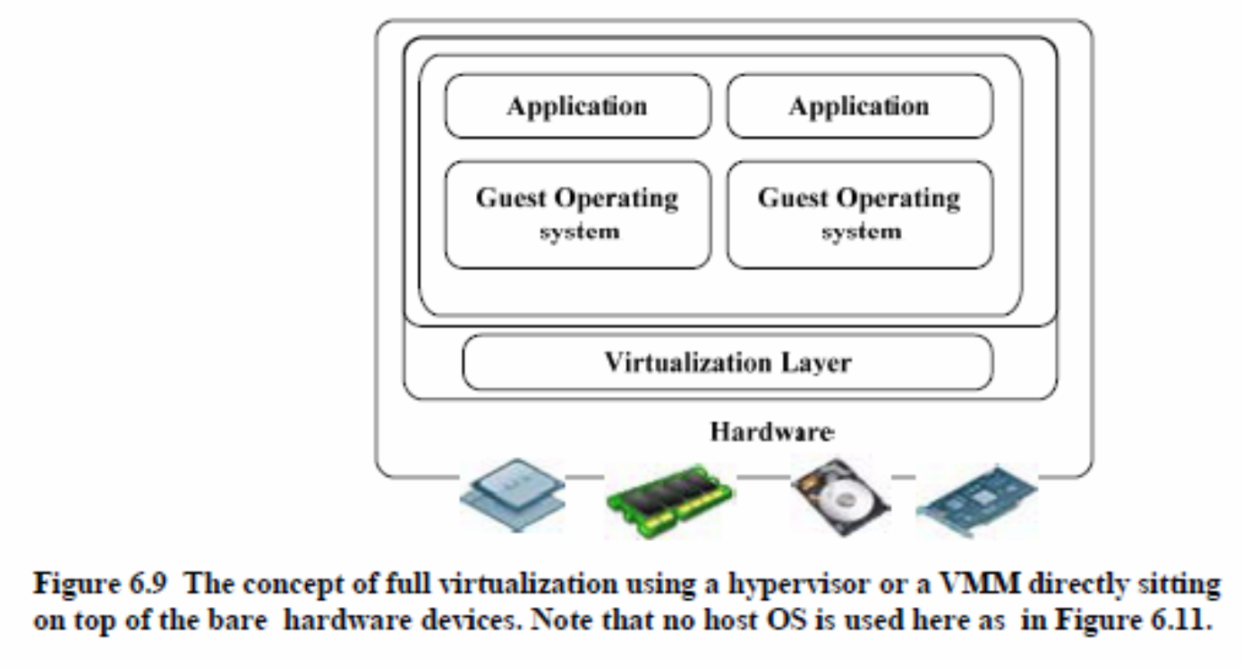
Full Virtualization

Slide 38
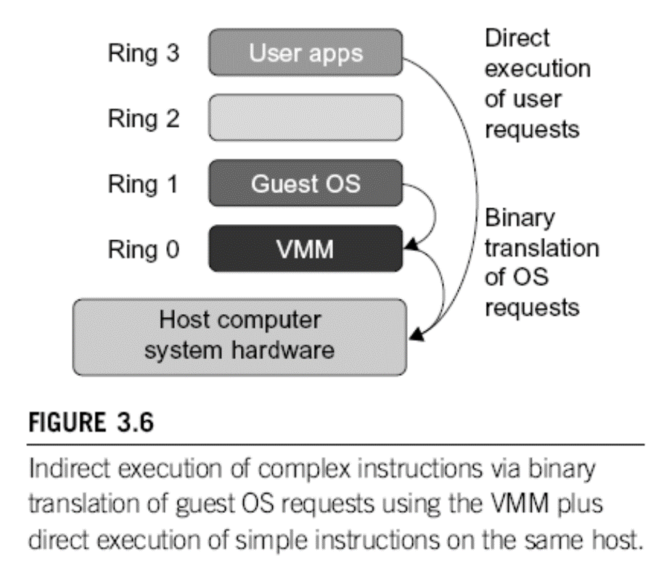
Binary Translation of Guest OS Requests using a VMM:

Slide 39
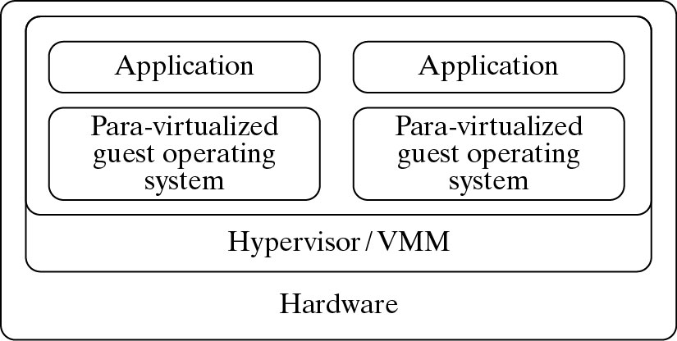
Para-Virtualization with Compiler Support.
The KVM builds offers kernel-based VM on the Linux platform, based on para-virtualization

Slide 40
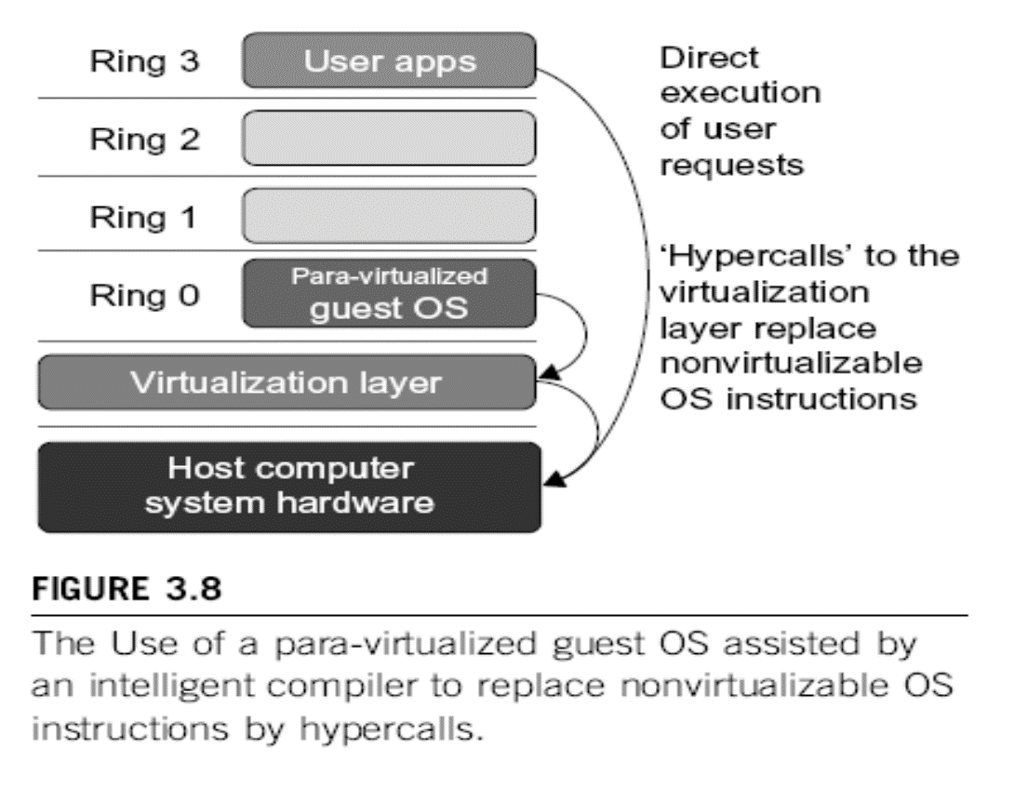

Slide 41
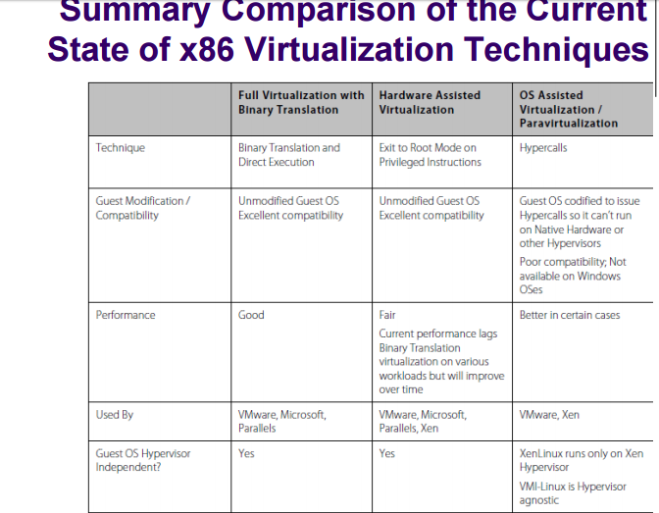

Slide 42
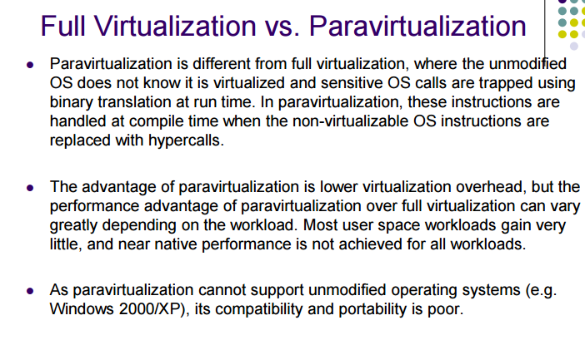

Slide 43
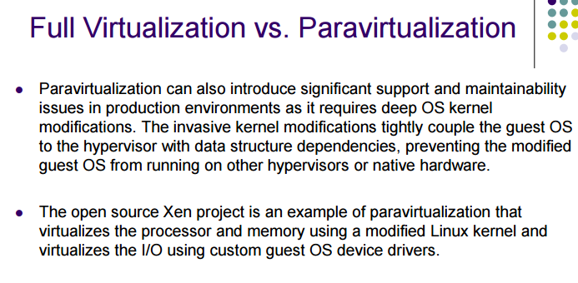

Slide 44
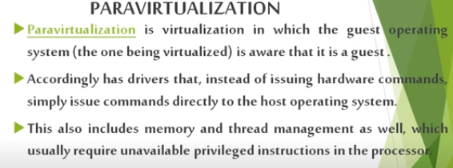

Slide 45
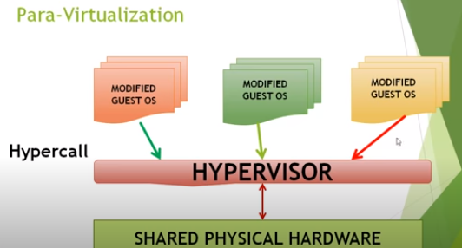
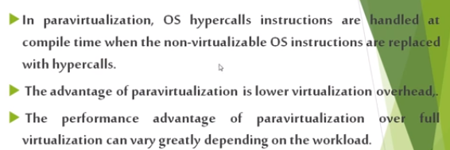

Slide 46
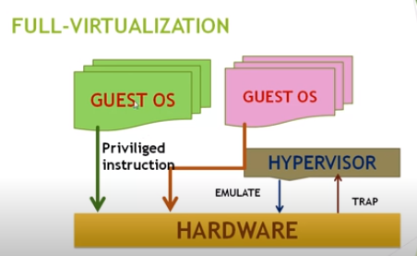
Full Virtualization

Slide 47
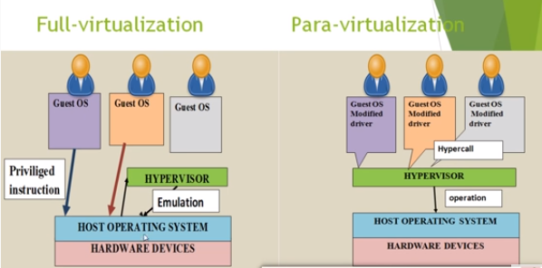

Slide 48
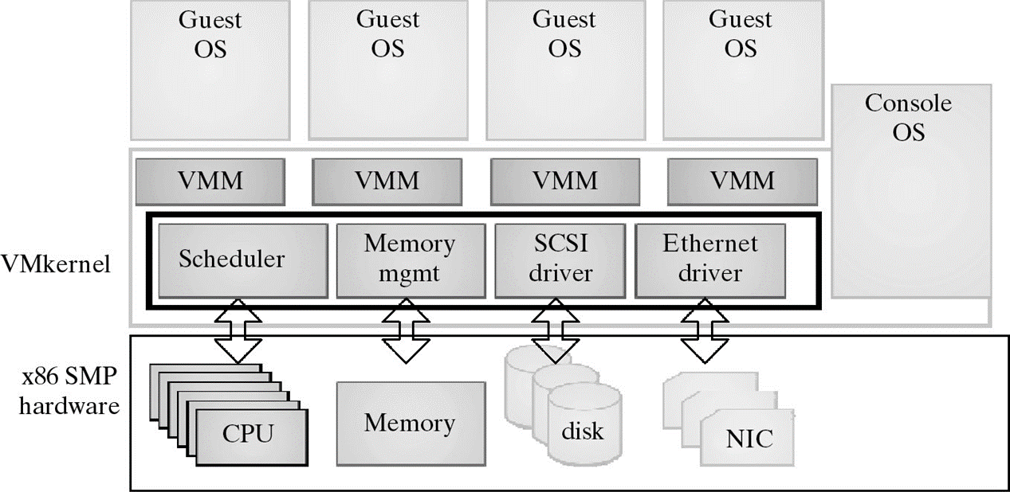
VMWare ESX Server for Para-Virtualization (self study)→ESX→ VMM

Slide 49
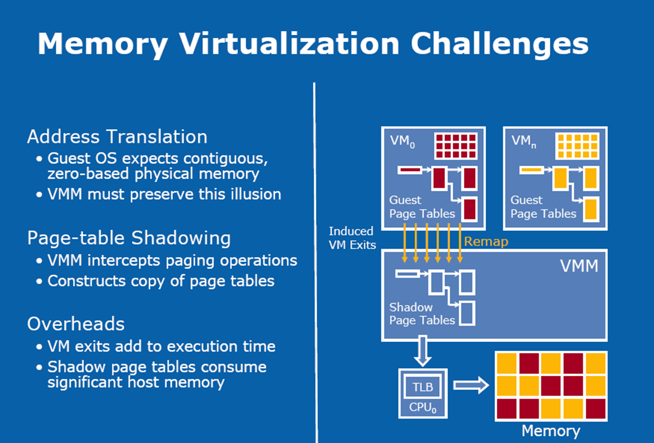

Slide 50
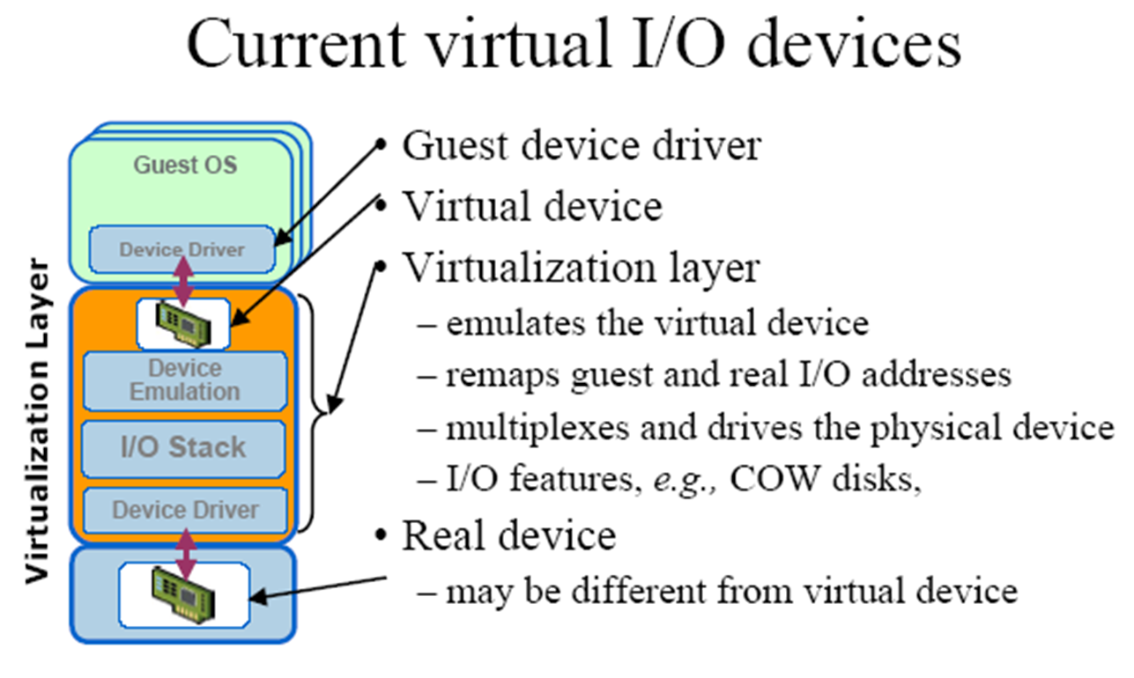
Copy on write disks

Slide 51
Conclusions on CPU, Memory and I/O Virtualization:
CPU virtualization demands hardware-assisted traps of sensitive instructions by the VMM
Memory virtualization demands special hardware support (shadow page tables by VMWare or extended page table by Intel) to help translate virtual address into physical address and machine memory in two stages.
I/O virtualization is the most difficult one to realize due to the complexity if I/O service routines and the emulation needed between the guest OS and host OS.

Slide 52
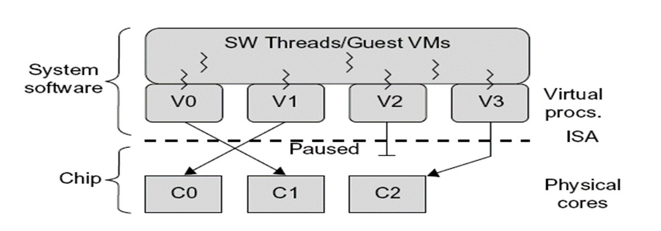
Multi-Core Virtualization: VCPU vs. traditional CPU
Figure 3.16 Four VCPUs are exposed to the software, only three cores are actually present. VCPUs V0, V1, and V3 have been transparently migrated, while VCPU V2 has been transparently suspended. (Courtesy of Wells, et al., “Dynamic Heterogeneity and the Need for Multicore Virtualization”, ACM SIGOPS Operating Systems Review, ACM Press, 2009 [68] )
Software visible VCPU moving from one core to another and temporarily suspending execution of a VCPU when there are no appropriate cores in which it can run.

Slide 53
Virtual Cores vs. Physical Processor Cores
Physical cores | Virtual cores
The actual physical cores present in the processor. | There can be more virtual cores visible to a single OS than there are physical cores.
More burden on the software to write applications which can run directly on the cores. | Design of software becomes easier as the hardware assists the software in dynamic resource utilization.
Hardware provides no assistance to the software and is hence simpler. | Hardware provides assistance to the software and is hence more complex.
Poor resource management. | Better resource management.
The lowest level of system software has to be modified. | The lowest level of system software need not be modified.

Slide 54
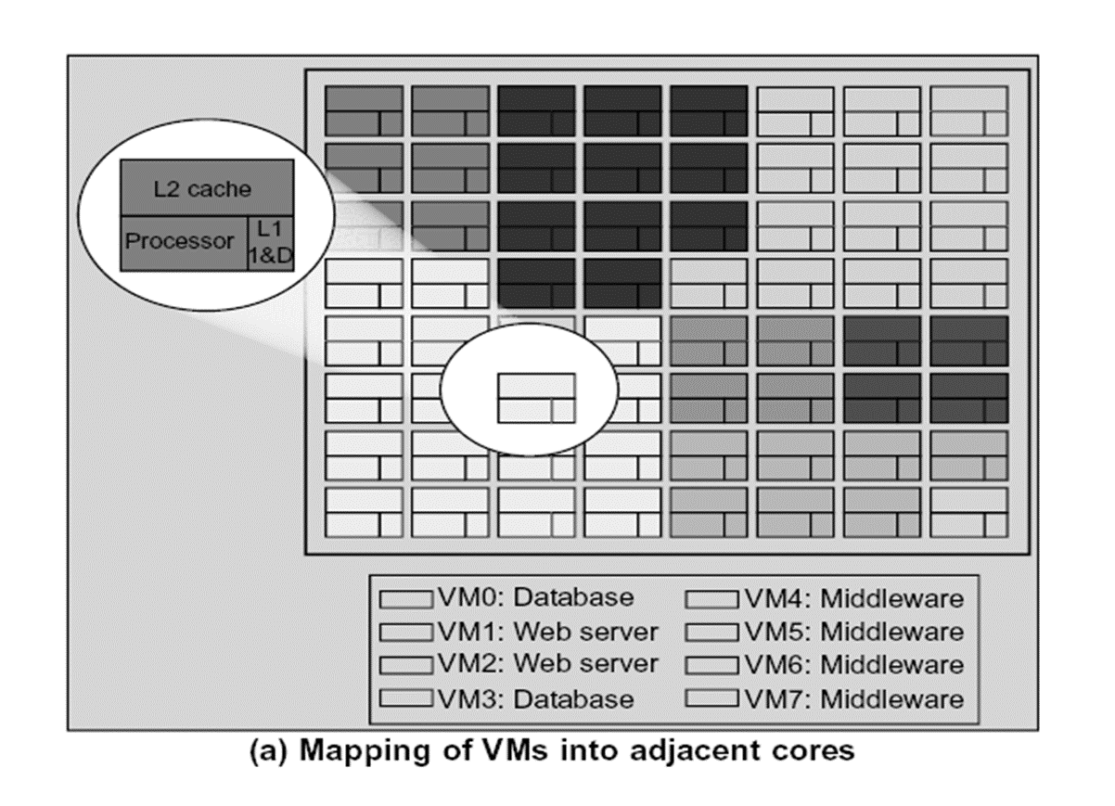

Slide 55
What is virtual cluster in CC
Virtual cluster are built with the VM’s installed at distributed servers from one or more physical clusters. The VM’s in a virtual cluster are interconnected logically by a virtual network across several physical networks.
Each virtual cluster is formed with physical cluster .It is formed with physical machines or the VM hosted by multiple physical clusters.
(diagram…………next page………….)

Slide 56
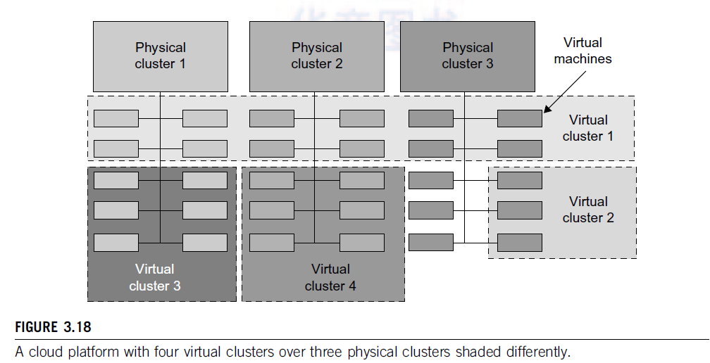

Slide 57
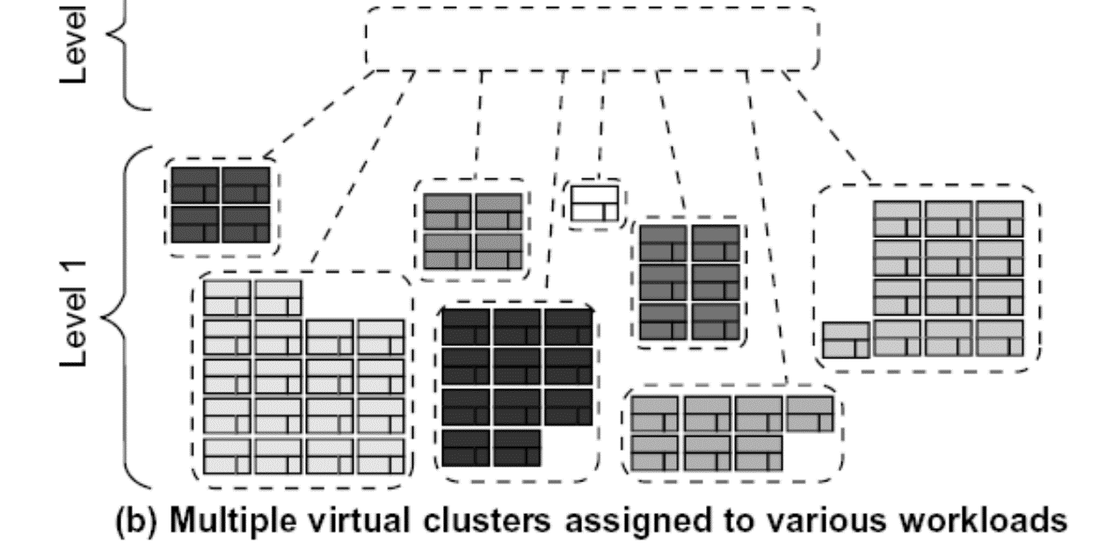
Virtual Clusters in Many Cores Space Sharing of VMs -- Virtual Hierarchy

Slide 58
Virtual Cluster Characteristics
The virtual cluster nodes can be either physical or virtual machines. Multiple VMs running with different OSs can be deployed on the same physical node.
A VM runs with a guest OS, which is often different from the host OS, that manages the resources in the physical machine, where the VM is implemented.
The purpose of using VMs is to consolidate multiple functionalities on the same server. This will greatly enhance the server utilization and application flexibility.

Slide 59
VMs can be colonized (replicated) in multiple servers for the purpose of promoting distributed parallelism, fault tolerance, and disaster recovery.
The size (number of nodes) of a virtual cluster can grow or shrink dynamically, similarly to the way an overlay network varies in size in a P2P network.
The failure of any physical nodes may disable some VMs installed on the failing nodes. But the failure of VMs will not pull down the host system.

Slide 60
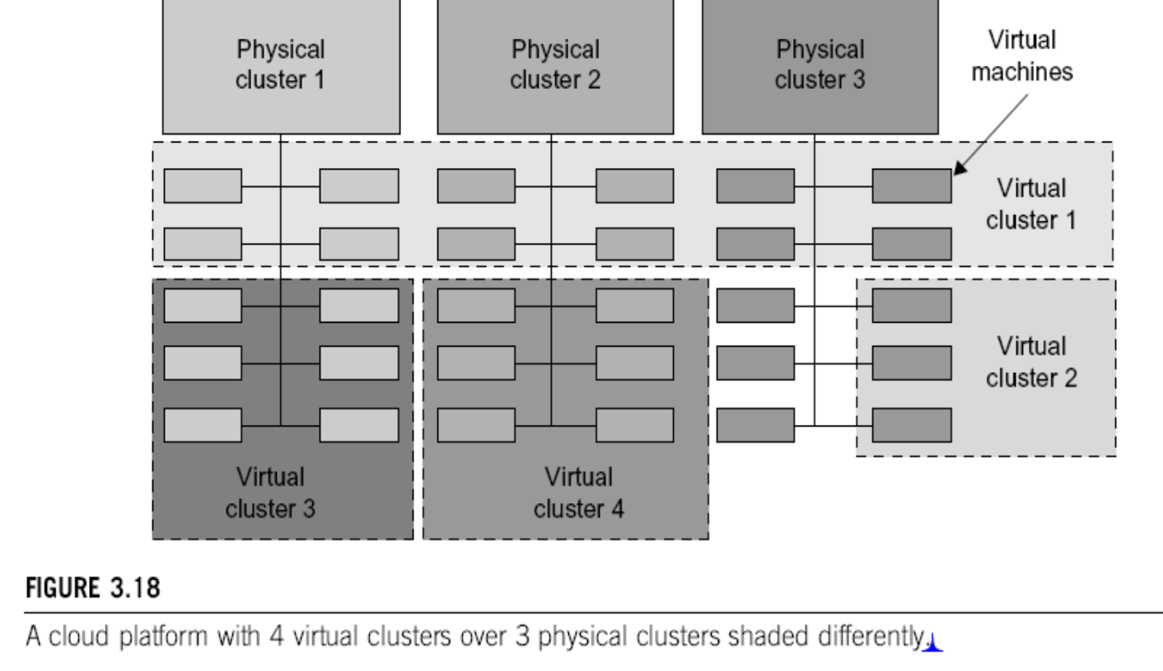
Virtual Clusters vs. Physical Clusters

Slide 61
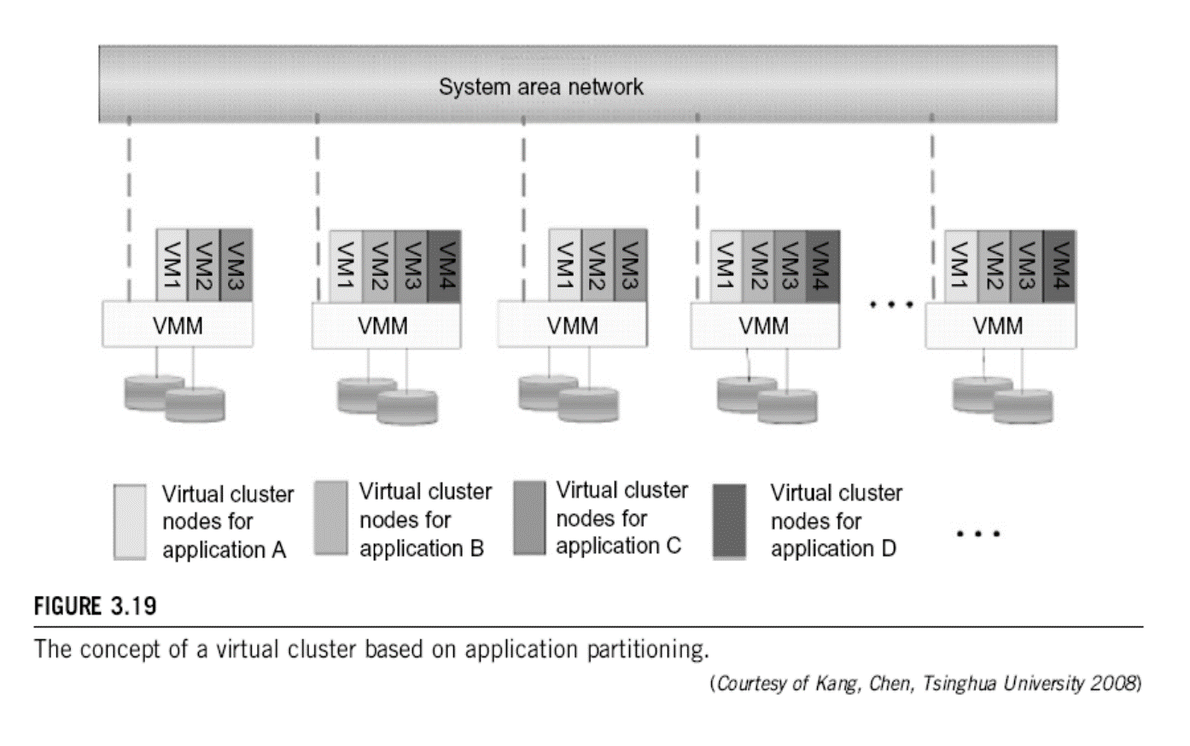

Slide 62
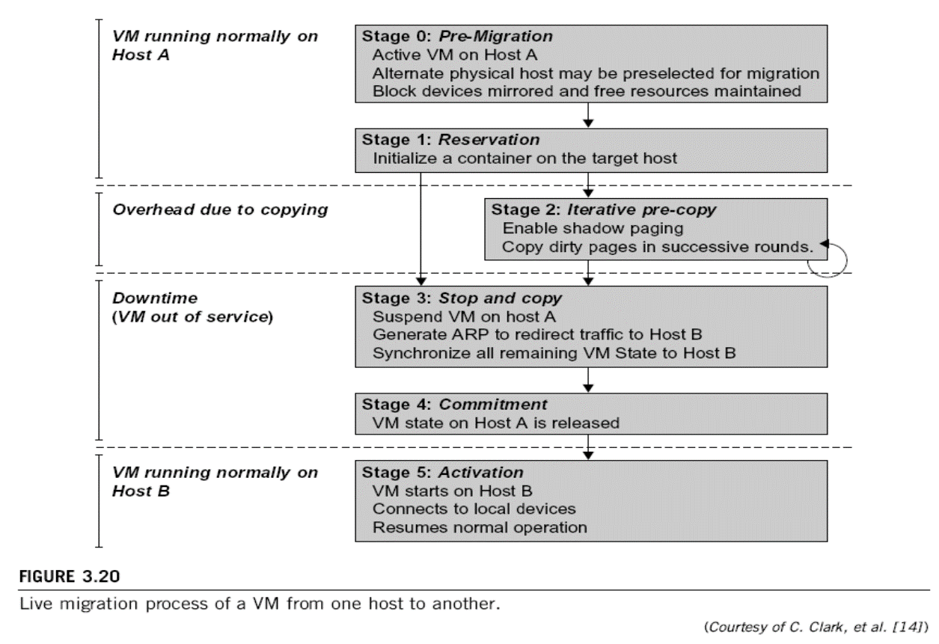
Live Migration of Virtual Machines

Slide 63
